Slide 1

Operation Analytics and Investigating Metric Spike
By Rohit Paul

Slide 2
overview
Operation Analytics is the analysis done for the complete end to end operations of a company. With the help of this, the company then finds the areas on which it must improve upon.
Operation analytics is a core part of any company. This kind of analysis is further used to predict the overall growth or decline of a company’s statistics. It helps to get better with automation, understanding between cross-functional teams and more effective workflows.
Metric investigation is an important part of operation analytics. With the help of it we can understand and help out team to understand and pinpoint the reasons behind maybe a drop in user-engagement, drop in sales or product growth.

Slide 3
Approach
The required data is already provided in the form of csv. Using the csv files, tables are created for respective databases.
When the tables are finally created, queries are written and executed to acquire the most relevant table for solving the problem. The resultant table is then exported for further processing.
Optimized and easily understandable charts are created from those exported table with the help of analytics software.
The charts helps us to get insights on the data and helps us to investigate & provide the required information to our team.

Slide 4
Tech-stack used
In this project, data is already provided in the form of csv files. Here MYSQL and PostgreSQL is used for case_study_1 and case_study_2 respectively to write optimised queries and due to absence of some functions in MYSQL.
For MYSQL, ms-dos is used to import the csv file and create table from it. Later MYSQL Workbench 8.0 CE is used to execute queries for case_study_1.
For PostgreSQL, pgadmin4 is used to import the csv file and create table from it as well as the queries are also executed for case_study_2.
The resultant table which is exported as a csv file which is then accessed with the help of Excel & Power BI to create chart and provide insights.
When optimized charts and insights are acquired powerpoint is used to create an easily understandable presentation.

Slide 5
Case study 1

Slide 6
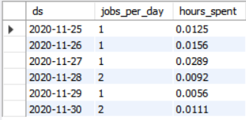
Number of jobs reviewed per hour per day for Nov 2020
Query:
select ds,count(job_id) as jobs_per_day, sum(time_spent)/3600 as hours_spent
from case_study_1
where ds >='2020-11-01' and ds <='2020-11-30'
group by ds
order by ds;
Result:
From the result we can see how much time(in hours) is spent on each job for the month of November, 2020.

Slide 7
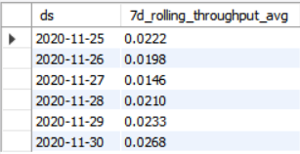
7 day rolling average of throughput
Query:
WITH A AS ( SELECT ds, COUNT(job_id) AS jobs, SUM(time_spent) AS total_time
FROM case_study_1
GROUP BY ds)
SELECT ds, SUM(jobs) OVER (ORDER BY ds ROWS BETWEEN 6 PRECEDING AND CURRENT ROW) /
SUM(total_time) OVER (ORDER BY ds ROWS BETWEEN 6 PRECEDING AND CURRENT ROW)
AS 7d_rolling_throughput_avg FROM A
Result:
For throughput, rolling averages are more preferred due to its usefulness for finding long term trends which would otherwise disguised by occasional fluctuations.

Slide 8
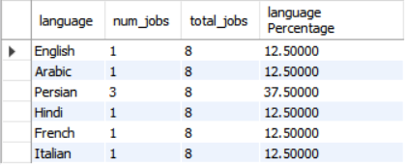
The percentage share of each language used in last 30 days
Query:
SELECT
language, count(*) as num_jobs, sum(count(*)) over() as total_jobs,
count(*) * 100.0 / sum(count(*)) Over() as 'language Percentage'
FROM
case_study_1
GROUP BY language;
Result:
We can see that Persian is most used languages in last 30 days.

Slide 9

Display duplicates from the table
Query:
SELECT
ds, any_value(job_id) as job_id, any_value(actor_id) as actor_id, any_value(event) as event,
any_value(language) as language, any_value(time_spent) as time_spent, any_value(org) as org
FROM
case_study_1
GROUP BY ds
HAVING count(ds) > 1;
Result:
These two are duplicate columns in the table.

Slide 10
Case study 2

Slide 11
Calculate the weekly user engagement
Query:
select
date_trunc('week', e.occurred_at) as date, count(distinct e.user_id) as weekly_user_engagement
from
events e
where
e.event_type = 'engagement' AND e.event_name = 'login'
group by
1
order by
1

Slide 12
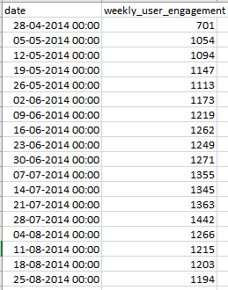
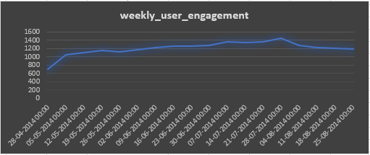
Calculate the weekly user engagement
Result and chart:
From the chart, we can see the fluctuations of weekly user engaging over time.

Slide 13
Calculate the user growth for product
Query:
select
date_trunc('month', u.created_at) as month, count(*) as all_users,
count(case when u.activated_at is not null then u.user_id else null end) as activated_users
from
users u
where
u.created_at >= '2013-01-01' and u.created_at <= '2014-08-31'
group by 1
order by 1

Slide 14
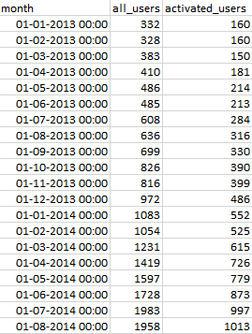
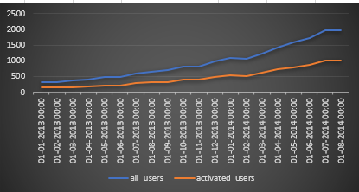
Calculate the user growth for product
Result and chart:
From the chart we can see the growth of total number of users along with activated users.

Slide 15
Calculate the weekly retention of users-sign up cohort
Query:
select
date_trunc('week', z.occurred_at) as "week",
avg(z.age_at_event) as "Average age during week",
count(distinct case when z.user_age > 70 then z.user_id else null end) as "10+ weeks",
count(distinct case when z.user_age < 70 and z.user_age >= 63 then z.user_id else null end) as "9 weeks",
count(distinct case when z.user_age < 63 and z.user_age >= 56 then z.user_id else null end) as "8 weeks",
count(distinct case when z.user_age < 56 and z.user_age >= 49 then z.user_id else null end) as "7 weeks",
count(distinct case when z.user_age < 49 and z.user_age >= 42 then z.user_id else null end) as "6 weeks",
count(distinct case when z.user_age < 42 and z.user_age >= 35 then z.user_id else null end) as "5 weeks",
count(distinct case when z.user_age < 35 and z.user_age >= 28 then z.user_id else null end) as "4 weeks",

Slide 16
Calculate the weekly retention of users-sign up cohort
count(distinct case when z.user_age < 28 and z.user_age >= 21 then z.user_id else null end) as "3 weeks",
count(distinct case when z.user_age < 21 and z.user_age >= 14 then z.user_id else null end) as "2 weeks",
count(distinct case when z.user_age < 14 and z.user_age >= 7 then z.user_id else null end) as "1 week",
count(distinct case when z.user_age < 7 then z.user_id else null end) as "less than a week"
from(
select e.occurred_at, u.user_id, date_trunc('week', u.activated_at) as activation_week,
extract('day' from e.occurred_at - u.activated_at) as age_at_event,
extract('day' from '2014-08-31'::timestamp - u.activated_at) as user_age
from users u
join events e
on e.user_id = u.user_id

Slide 17
Calculate the weekly retention of users-sign up cohort
and e.event_type = 'engagement'
and e.event_name = 'login'
and occurred_at >= '2014-05-01'
and occurred_at < '2014-08-31'
where u.activated_at is not null) z
group by 1
order by 1

Slide 18
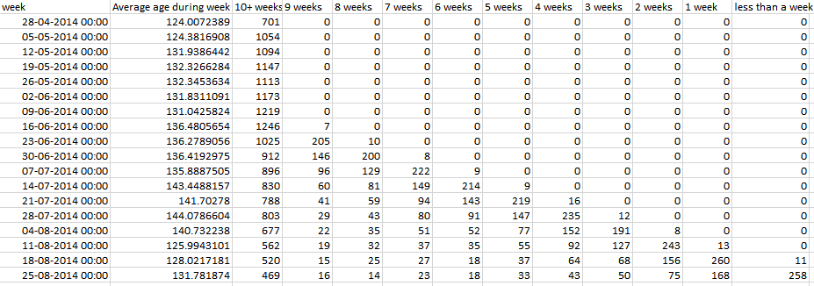
Calculate the weekly retention of users-sign up cohort
Result and chart:

Slide 19
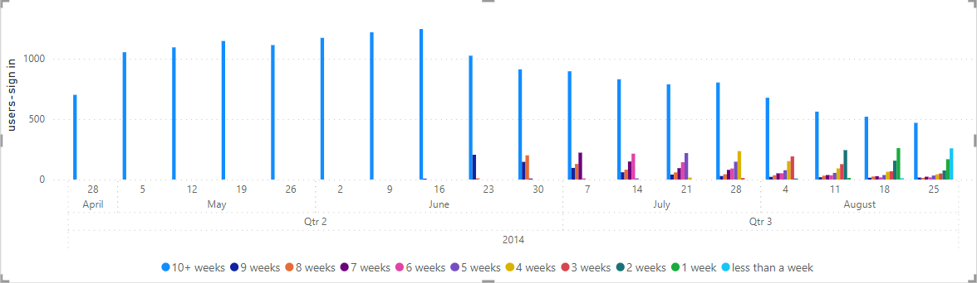
Calculate the weekly retention of users-sign up cohort
Result and chart:
Cohort analysis is a tool to measure user engagement over time. It helps to know whether user engagement is actually getting better over time or lack of activity of the old users is being hidden by the impressive growth numbers of new users.

Slide 20
Calculate the weekly engagement per device
Query:
select date_trunc('week', e.occurred_at) as week, count(distinct e.user_id) as weekly_users,
count(distinct case when e.device in ('macbook pro', 'acer aspire notebook','acer aspire desktop', 'lenovo thinkpad', 'mac mini', 'dell inspiron desktop','dell inspiron notebook','windows surface','macbook air','asus chromebook','hp pavilion desktop') then e.user_id else null end) as computer,
count(distinct case when e.device in ('iphone 5s','nokia lumia 635','amazon fire phone','iphone 4s', 'htc one','iphone 5', 'samsung galaxy s4') then e.user_id else null end) as phone,
count(distinct case when e.device in ('kindle fire','samsung galaxy note','ipad mini','nexus 7', 'nexus 10','samsung galaxy tablet','nexus 5','ipad air') then e.user_id else null end) as tablet
from events e
where e.event_type = 'engagement' and e.event_name = 'login'
group by 1
order by 1

Slide 21
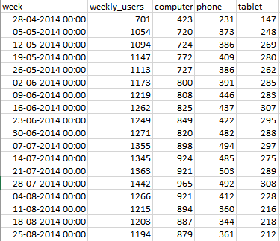
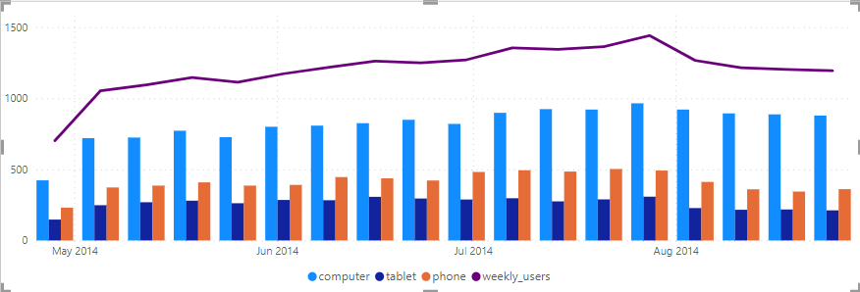
Calculate the weekly engagement per device
Result and chart:
From the chart we can see the total number of users and from which platform/type of devices they use mostly.

Slide 22
Calculate the email engagement matrices
Query:
select date_trunc('week',e.occurred_at) as week,
count(case when e.action = 'sent_weekly_digest' then e.user_id else null end) as weekly_emails,
count(case when e.action = 'sent_reengagement_email' then e.user_id else null end) as reengagement_emails,
count(case when e.action = 'email_open' then e.user_id else null end) as email_opens,
count(case when e.action = 'email_clickthrough' then e.user_id else null end) as email_clickthroughs
from email_events e
group by 1
order by 1

Slide 23
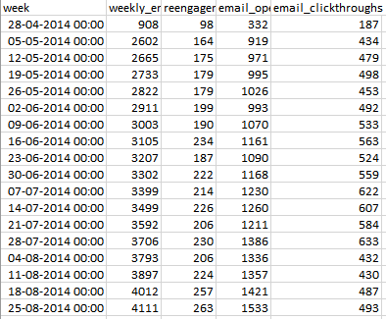
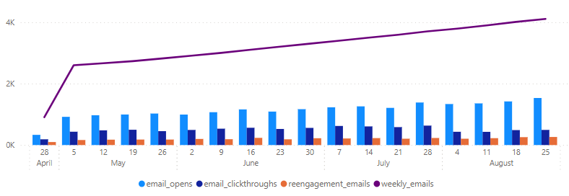
Calculate the email engagement matrices
Result and chart:
With the help of this chart we can see the weekly emails with the help of line graph and with the help of bar charts we can see the number of emails which are opened, the link is visited in it and re-engagement emails.

Slide 24
Conclusion
In summary, operation analytics is one of the most powerful tool to investigate matices spikes in an organizational data and pinpoint the reasons of either success or downfall of that organization. These insights later helps team members to provide recommendation which could help resolving any issue the organization has been facing.
From case study 1 we can see that, rolling throughput average is better because it can provide us that key occasional fluctuations which helps analysts and team member understand more about the data.
From case study 2 we can see how users are engaging with the organization and helping in product growth. We also get to know, how much an organization is able to retain its old users with the help of user retention cohort. We can also get to know from which type of device users are mostly accessing the product and also how users are engaging with the email services.
These key points will help to generate a clear image of where the organization is lacking and take steps according to it.

Slide 25
THANK YOU

